Slide 1

NATIONAL UNIVERSITY OF MODERN LANGUAGES
Faculty of Engineering and Computing
Department of Software Engineering

Slide 2

SOFTWARE DESIGN AND ARCHITECTURE
LECTURE NO. 1
Introduction to Software Engineering Design
Course Instructor: | Mr. Ahsan Arif
 | Lecturer Department of Software Engineering NUML Islamabad
Date: September 09, 2024
Software Engineering Design: Theory and Practice

Slide 3
LECTURE CONTENTS
Introduction to Software Engineering Design
  Conceptual Overview
  Engineering Design
  Engineering Problem Solving
    Initial State
    Operational State
      Thinking about the Problem
      Problem Solution
    Goal State
Date: September 09, 2024
Software Engineering Design: Theory and Practice

Slide 4
CONCEPTUAL OVERVIEW
Software design is crucial in software engineering, guiding the creation of high-quality systems within budget and on schedule.
  Purpose:
  It transforms requirements into technical models before construction, ensuring quality is built in from the start.
  Key Elements:
  Understanding design principles, processes, and strategies is essential for effective design in modern software systems.
With proper knowledge and understanding of roles, designers can excel in designing large-scale systems in diverse conditions.
Date: September 09, 2024
Software Engineering Design: Theory and Practice

Slide 5
ENGINEERING DESIGN
Civil Engineering
Plans for physical environments like bridges, roads, and buildings
Electrical Engineering
Detailed descriptions for telecommunication and electronic systems
Mechanical engineering
Analysis and specification of technical features for machines and tools
In all other engineering disciplines, Design ensures products meet intended functions and user expectations systematically.
Date: September 09, 2024
Software Engineering Design: Theory and Practice

Slide 6
Formally, engineering design defined as;
Design is a intelligent process in which designers generate and evaluate designs for devices or systems to meet client objectives and user needs within specified constraints
WHY…?
Conduct Design in Engineering disciplines…
Conducting design in engineering helps create safe, efficient, and innovative solutions to real-world problems while balancing costs and meeting user needs.
Date: September 09, 2024
Software Engineering Design: Theory and Practice

Slide 7
ENGINEERING PROBLEM SOLVING
Problem Solving Process
Problem solving during design occurs in three different states:
  Initial state
  Operation state
  Goal state
In these stages, designers use different methods to create a landscape where problems can be solved effectively.
In Initial state formulating and interpreting problems. Once, problems are well understood, designers move to operational state, where thinking about the problem occurs and generating viable solutions come to light. Once an appropriate solution is identified, evaluated, and validated, designers move to the goal state, where a final solution to the problem is found, marking the end of the problem-solving process.
Date: September 09, 2024
Software Engineering Design: Theory and Practice

Slide 8
Initial State:
  Design problems vary in size and complexity, impacting time and effort.
  Some problems are harder to solve, requiring adjusted strategies.
  Differentiating problem types helps manage effort, time, and risk effectively.
Problem Classification
Well-defined
Ill-defined
Wicked
Problem with clear goals and known constraints
Problem with no definite solution; not understood until after the formulation of its solution
Problem with undefined or ambiguous goals and unknown constraints
Date: September 09, 2024
Software Engineering Design: Theory and Practice

Slide 9
Operational State:
  Problem solution is actively considered.
  Designers use diverse problem-solving techniques such as breaking down problems (divide and conquer), reusing solutions (patterns), etc.
    They need a “think outside the box” mentality, shifting from conventional to unconventional approaches for complex problem-solving.
  Thinking about the Problem
    When learning about a problem for the first time, problem solvers may begin by asking questions, which allows them to think about many different alternative solutions; as the problem-solving process moves forward, problem solvers can begin narrowing down the possibilities and think about the single best solution to the problem. These types of thinking are known as convergent thinking and divergent thinking.
Date: September 09, 2024
Software Engineering Design: Theory and Practice

Slide 10
Types of Thinking
Convergent thinking
Divergent thinking
Type of thinking that seeks to find one single solution to a problem
Type of thinking that seeks to find multiple solutions to a problem
  Convergent and divergent thinking are vital in engineering problem-solving. Divergent thinking explores various abstraction levels, offering nuanced solutions, while convergent thinking synthesizes these ideas into a final solution.
Date: September 09, 2024
Software Engineering Design: Theory and Practice

Slide 11
  Problem Solution
  Identifying the right solution approach can save time and resources. Sometimes, aiming for an approximate solution that meets project constraints is more efficient than seeking the perfect one. This approach reduces the time and budget needed for system development.
Types of Problem Solution
Algorithm
Heuristic
Fixed set of rules that lead to the solution of a problem
Rules of thumb (or procedure) that may or may not lead to the solution of a problem
Date: September 09, 2024
Software Engineering Design: Theory and Practice

Slide 12
Goal State:
  The goal state is the final state in problem-solving. For engineering problems, reaching this state requires attention to detail.
  Combining initial, operational, and goal states forms a comprehensive problem-solving framework (holistic approach to problem solving).
  The approach consists of the following tasks:
    Interpret problem
    Evaluate constraints
    Collaborative brainstorming
    Synthesize possibilities
    Evaluate solution
    Implement solution
Date: September 09, 2024
Software Engineering Design: Theory and Practice

Slide 13
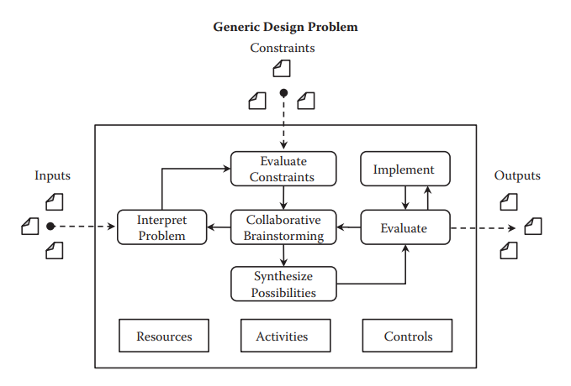
Holistic approach to problem solving…
Date: September 09, 2024
Software Engineering Design: Theory and Practice

Slide 14
Interpreting the problem
  Performed during the Initial State of problem-solving.
  Problem classification, e.g. well-defined, ill-defined, wicked.
Evaluate constraints
  Identify external constraints to set bounds on the solution landscape.
Collaborative brainstorming
  Performed during the Operational State of problem-solving.
  Think about the different solutions to the problem, i.e. divergent thinking.
Synthesize possibilities
  Performed during the Operational State of problem-solving.
  Switch to convergent thinking to seek one acceptable solution.
Evaluate solution
  Performed during the Operational State of problem-solving.
  Flaws in the solution may trigger a transition back to the collaborative brainstorming activity.
Date: September 09, 2024
Software Engineering Design: Theory and Practice

Slide 15
Problem-Solving Process Variables:
Phase | Description
Activities | One or more tasks identified and required to solve the problem
Resources | Means by which activities are performed
Controls | Internal properties of the organization that place bounds on the solution, or the solution process, for the problem
Date: September 09, 2024
Software Engineering Design: Theory and Practice
Notes:
"Internal properties of the organization" are factors within the organization, like policies, resources, or culture, that set limits on how solutions can be developed or implemented.

Slide 16
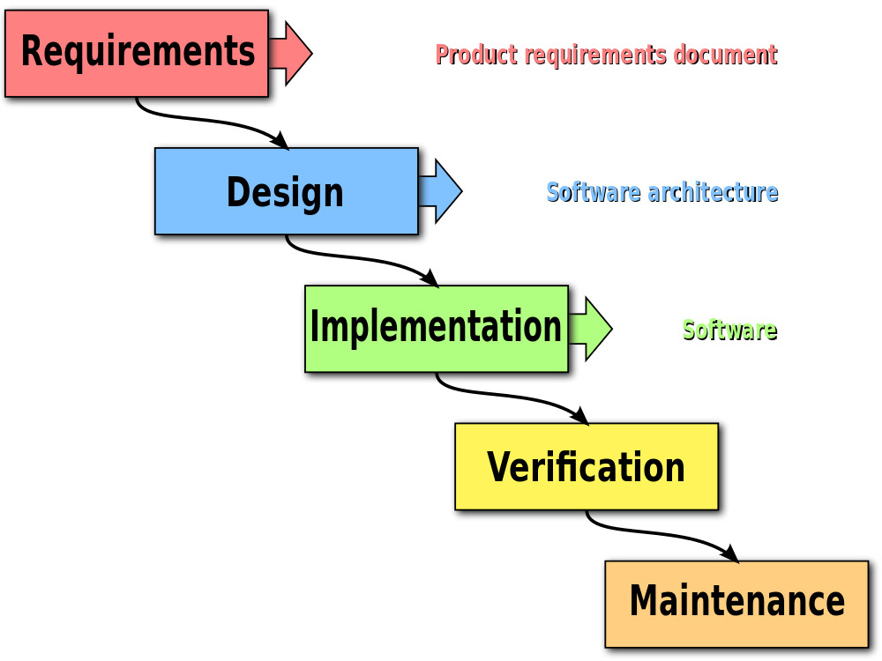
SOFTWARE ENGINEERING DESIGN
Let’s revisit the Software Development Life Cycle (SDLC)
Date: September 09, 2024
Software Engineering Design: Theory and Practice

Slide 17
Thank You...
Mr. Ahsan Arif
Lecturer (Dept. of Software Engineering)
ahsanarif.se42@gmail.com

